Slide 1
Combining Hard and Soft System Information Systems in Organizational Design and Applied System Thinking Furkan Yücebaş

Slide 2
Outlines
System Approaches
Soft System Approaches
Hard System Approaches
Differences between hard and soft system methodologies
Soft and Hard Tools
Combining Soft and Hard Systems
Case Study
Conclusion

Slide 3
System Approaches
There’s different ways of viewing a system: – Soft systems approach – Hard systems approach
• Two ends of a scale, a bit grey in the middle

Slide 4
Soft System Approach
Engineering approach can be inappropriate for ‘soft problems’ (with fuzzy requirements).
Soft systems approaches (Soft Systems Methodology, Soft OR) assume: – organisational problems are ‘messy’ or poorly defined – stakeholders interpret problems differently (no objective reality) – human factors important – creative, intuitive approach to problem-solving – outcomes are learning, better understanding, rather than a ‘solution’

Slide 5
Hard Systems Approach
Hard systems approaches (systems analysis (structured methods), systems engineering, operations research) assume: – Objective reality of systems in the world – Well-defined problem to be solved – Technical factors foremost – Scientific approach to problem-solving – An ideal solution
More traditional way of viewing systems in Computing Science

Slide 6
Differences between hard and soft systems methodologies?
HARD systems - rigid techniques and procedures to provide unambiguous solutions to well-defined data and processing problems problems, focused on computer implementations
SOFT systems - a loose framework of tools to be used at the discretion of the analyst, focused on improvements to organisational problems

Slide 7
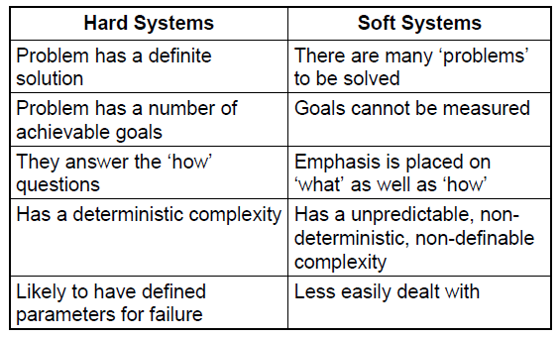
Hard vs Soft Systems

Slide 8
Concept Mapping
Can be linked together in order to ensure a smooth flow of information between the conceptualisation phase of the system and its quantitative analysis, and between the people’s needs and the development of solutions
First developed with the involvement of local people and local experts
Then used to guide the design of quantitative models

Slide 9
Soft Systems Methodology
The participatory process Workshops Scenario planning Capacity building
Qualitative research

Slide 10
Soft Systems Methodology : Qualitative research
The focus of qualitative research tends to be on understanding the meaning imbedded in participant experiences through an open-ended, unstructured and subjective approach (Lincoln and Guba, 1985). The researcher builds a complex, holistic picture, analyses words, reports detailed views of informants and conducts the study in a natural setting. Concept maps can provide one strategy to deal with the methodological challenges of qualitative research.
Sophisticated computerised software programs have been developed to assist with the data analysis process in qualitative research.

Slide 11
Hard Systems Methodology : Quantitative research
Objective is to develop and employ mathematical models, theories and/or hypotheses pertaining to natural phenomena. The process of measurement is central to quantitative research because it provides the fundamental connection between empirical observation and mathematical expression of quantitative relationships.
key innovation proposed here is focused on reducing the gap between research and management priorities. The use of concept maps is a key element of this strategy. On the one hand, it helps in managing the information flow in the participatory process, while on the other hand it helps to create a link between qualitative and quantitative modelling.

Slide 12
Combining Hard and Soft System Methodology
Each approach has its own strengths in dealing with the complexity of systems from a variety of perspectives
We need to create a link between qualitative and quantitative modeling

Slide 13
Case Study :
The key tool for this qualitative process is the concept map. This allows us on the one hand to manage the information flow in the participatory process, while on the other hand to create a link between qualitative and quantitative modelling
Soft and hard tools that can be used for the management of socio-ecosystems in mountain areas. We then show how they can be linked together in order to ensure a smooth flow of information between the conceptualisation phase of the system and its quantitative analysis, and between the people’s needs and the development of solutions.

Slide 14
The case-study: The HKKH Partnership Project
Aim: to improve ecosystem management in the Hindu Kush-Karakoram-Himalaya (HKKH) region.
Focused in three national parks: Sagarmatha National Park (SNP) in Nepal, Central Karakoram National Park (CKNP) in Pakistan and Quomolongma Nature Preserve (QNP) in Tibet Autonomous Region of PR China. The implementation of the project recognises the specific characteristics of each site, and allows for political and knowledge constraints. *Paper focuses on the SNP site in Nepal, because there is more knowledge about the socio-ecological dynamics of this site, and the park management is well developed

Slide 15
The methodological approach
to the management of SESs proposed by Walker et al.(2002)
Walker’s framework is based on four steps: 1. System description through stakeholder participation; 2. Identification of possible future trajectories of the system; 3. Quantitative analysis of system; 4. Participatory and integrated assessment of policy and management implications.

Slide 16
System description through stakeholder participation
The Protocol for the qualitative modelling:
Prepared for the preparation of the qualitative diagrams in CmapTools
Aim: to introduce some degree of formality into the qualitative modelling process.

Slide 17
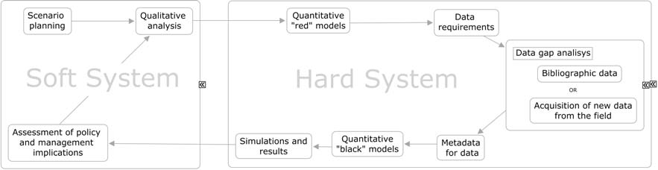
Steps proposed in the HKKH Partnership Project for the overall socio-ecosystem analysis and modelling

Slide 18
Conclusion
We can combine hard and soft system methodology in some project.
Each approach has its own strengths in dealing with the complexity of systems from a variety of perspectives

Slide 19
Thank you for your listening☺

